Slide 1
Maximal Independent Set
Parallel Algorithm

Slide 2
Definition
Graph = { Nodes, Neighbors }
If a node is in the independent set, then all of its neighbors cannot be in the independent set.
An independent set is maximal when no more nodes can be added to the set without incurring an edge, whereas an independent set is maximum when it’s the largest possible size for the given graph.

Slide 3
Algorithm
Assign each node in graph a priority [0.0, 1.0]
While graph is not empty:
For each node in graph:
Compare node priority to neighbors’ priority
If max priority:
Add node to independent set
Remove node’s neighbors from graph
Remove node from graph

Slide 4
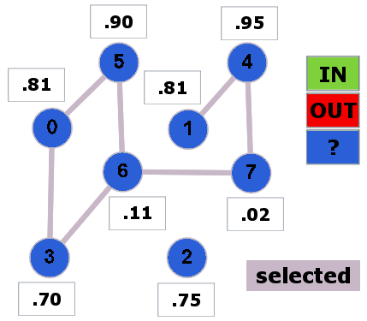

Slide 5
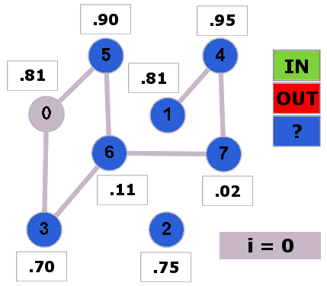

Slide 6
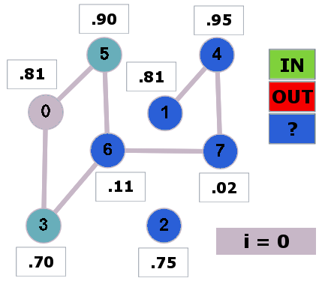

Slide 7
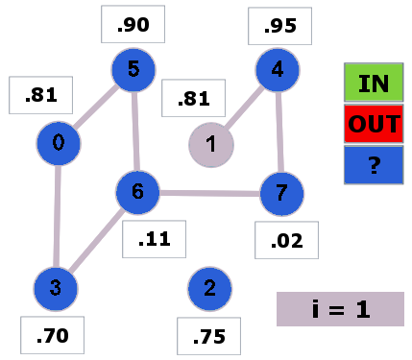

Slide 8
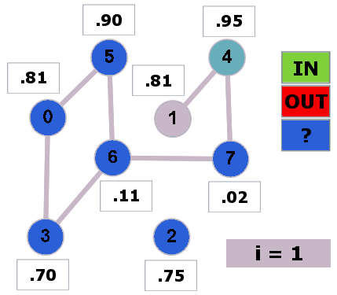

Slide 9
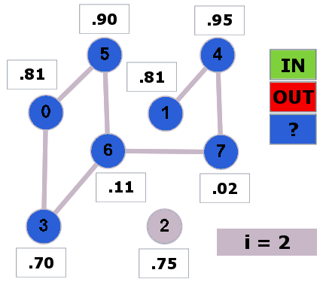

Slide 10
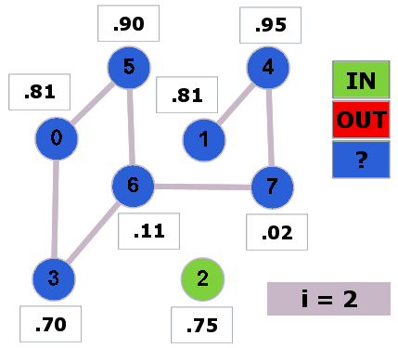

Slide 11
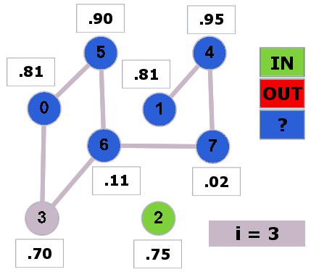

Slide 12
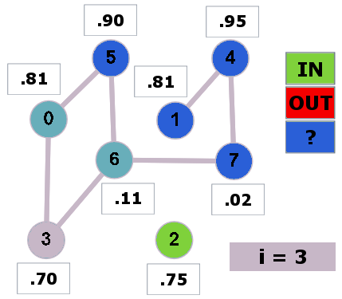

Slide 13
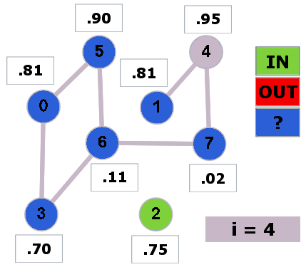

Slide 14
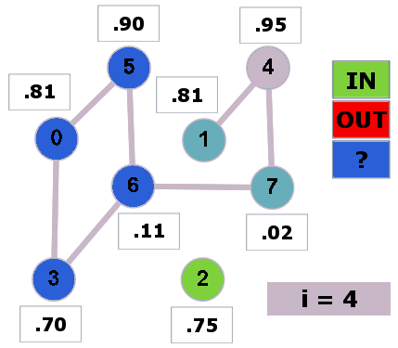

Slide 15
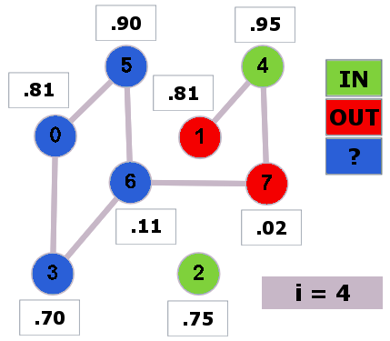

Slide 16
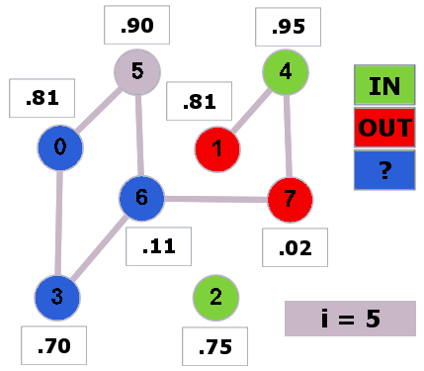

Slide 17
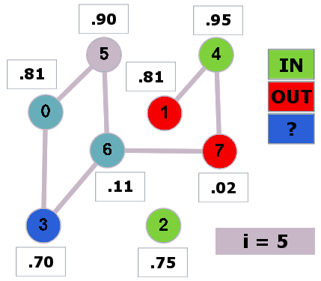

Slide 18
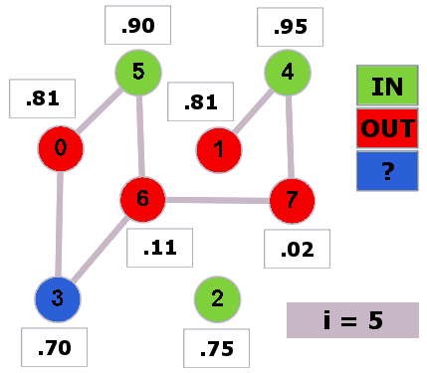

Slide 19


Slide 20


Slide 21


Slide 22


Slide 23


Slide 24
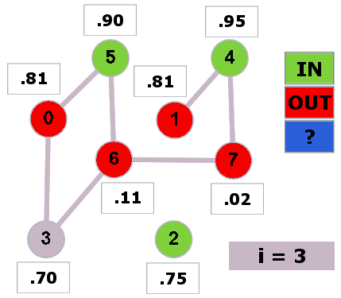

Slide 25


Slide 26


Slide 27
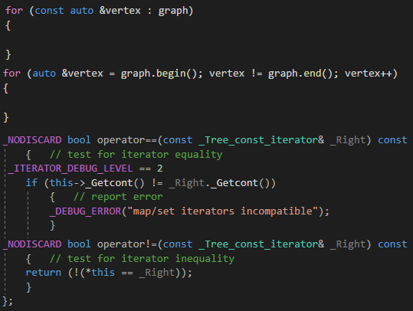
C++ Implementation
OpenMP (shared memory)
: not allowed (only canonical form)
!= invalid controlling predicate
< not allowed for bidirectional iterator

Slide 28
